Slide 1



CHILL PEPPER DISEASE DETECTION USING DEEP LEARNING ALGORITHM
BY
P.VIGNESHWARAN

Slide 2


Introduction to Chili Diseases
Chili are susceptible to various diseases that can affect their growth and yield. Common diseases include bacterial spot, powdery mildew, and phytophthora blight. These diseases can cause leaf spots, fruit rot, and overall decline in plant health. Proper identification and management of these diseases are essential for successful bell pepper cultivation.

Slide 3
Importance of detecting diseases in bell peppers
Early Detection
Prevent Spread
Sustainable Farming
Early detection can prevent widespread crop damage and loss of yield.
Detecting diseases early can prevent the spread to other plants in the field.
Detecting and treating diseases supports sustainable and healthy agriculture practices.

Slide 4

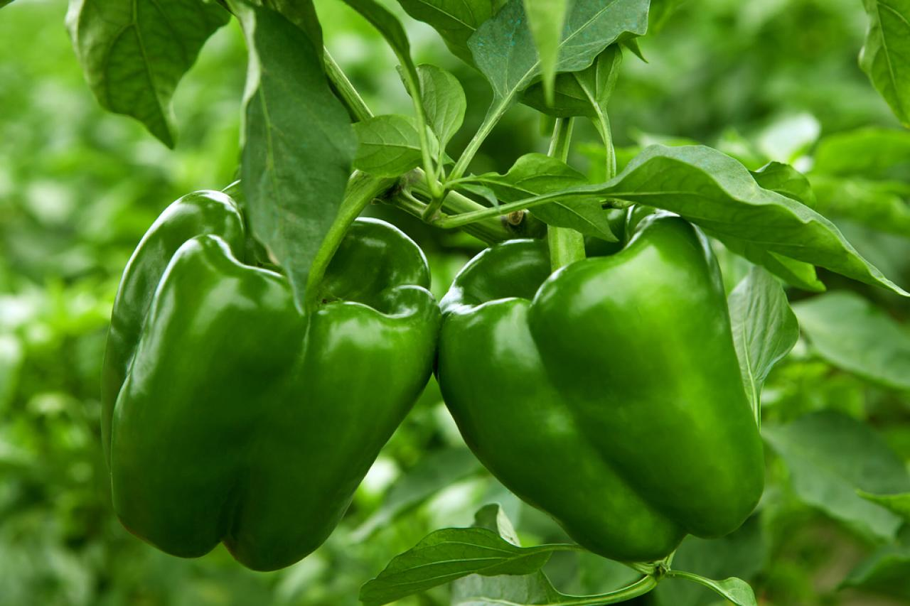
Common diseases affecting Chili
Bacterial spot: Characterized by water-soaked lesions on leaves and fruits
Anthracnose: Causes circular, sunken lesions on immature fruit
Phytophthora blight: Leads to wilting of the entire plant

Slide 5


Symptoms and signs of Chili diseases
1
Discoloration
Bell peppers with diseases may show yellow, brown, or black spots on the leaves and fruit.
2
Deformities
Abnormal growth, misshapen or stunted fruit, and distorted leaves are common signs of disease.
3
Wilting
Diseased plants may exhibit wilting, drooping, or withering of leaves, indicating underlying issues.

Slide 6
Methods for Detecting Diseases in chili
Visual Inspection
Biological Testing
Molecular Testing
A visual examination of the bell pepper plants for any abnormalities or discoloration.
Utilize biological assays to identify the presence of specific pathogens or bacteria.
Employ DNA-based techniques such as PCR to detect the genetic material of pathogens.
This method involves isolating and culturing samples from the affected plants for analysis.
Molecular testing offers high precision in identifying disease-causing agents in bell peppers.
Check for any signs of pest infestations that could contribute to diseases.
.

Slide 7



Visual inspection and identification of diseases
Magnifying Glass
Hand Lens
Visual Spotting
Close examination of leaves and stems for tiny pests or discoloration.
Using a hand lens to spot small spots or lesions on the plant surface.
Noting irregular spots, color changes, or deformities on the bell pepper.

Slide 8
Laboratory testing for accurate disease detection
Method
Accuracy
Turnaround Time
PCR (Polymerase Chain Reaction)
High
Several hours to a day
ELISA (Enzyme-linked Immunosorbent Assay)
High
Several hours to a day
Microscopy
Variable
Several hours to several days

Slide 9
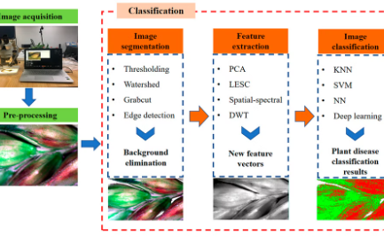
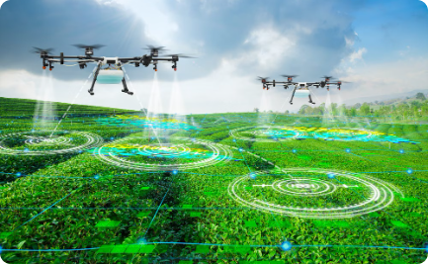

Technology-based approaches for disease detection
Hyperspectral Imaging
Drone-based Monitoring
Machine Learning
Hyperspectral imaging captures detailed spectral information to identify specific diseases based on their unique signatures.
Machine learning algorithms analyze large datasets to accurately identify and diagnose diseases affecting bell pepper plants.
Drones equipped with multispectral cameras enable efficient and extensive monitoring of bell pepper fields for disease detection.

Slide 10
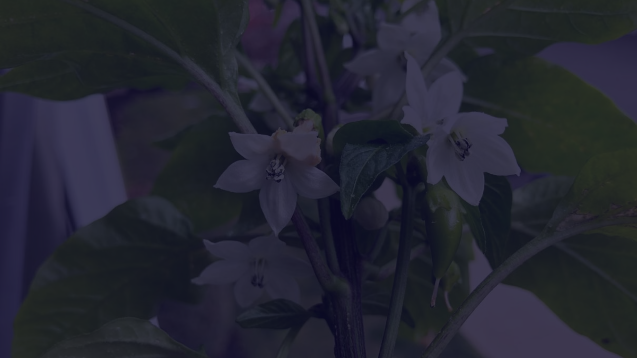
Benefits of Early Detection and Prevention
Reduced Crop Loss
Cost Savings
Sustainable Agriculture
Early detection allows for prompt action, reducing the risk of crop damage and loss.
Prevention is more cost-effective than dealing with the consequences of a full-blown disease outbreak.
Early prevention supports sustainable farming practices and preserves crop health for the long term.

Slide 11
Conclusion and key takeaways
Early detection of bell pepper diseases is crucial for ensuring the health and yield of crops.
By implementing visual inspections, laboratory testing, and technology-based approaches, farmers can prevent widespread damage from diseases.
Proactive measures based on accurate disease detection can lead to sustainable and thriving bell pepper cultivation.

Slide 12


